Slide 1
Introduction to Regression Part B: Error Evaluation and Model Comparison

Slide 4
Error Evaluation

Slide 5
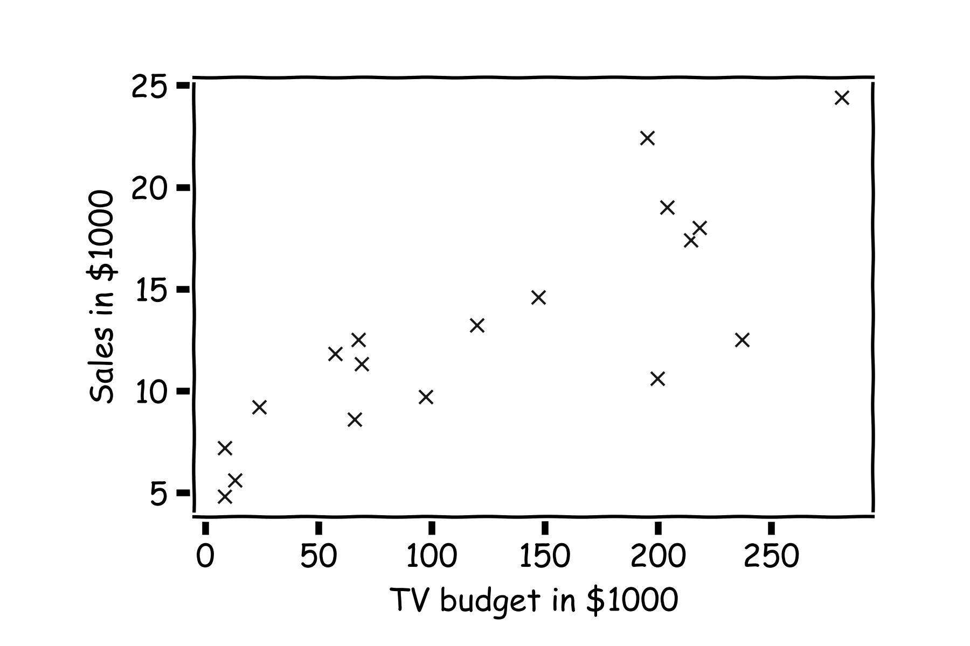
Error Evaluation
Start with some data.
Notes:
Change indeces and show k-nearest

Slide 6
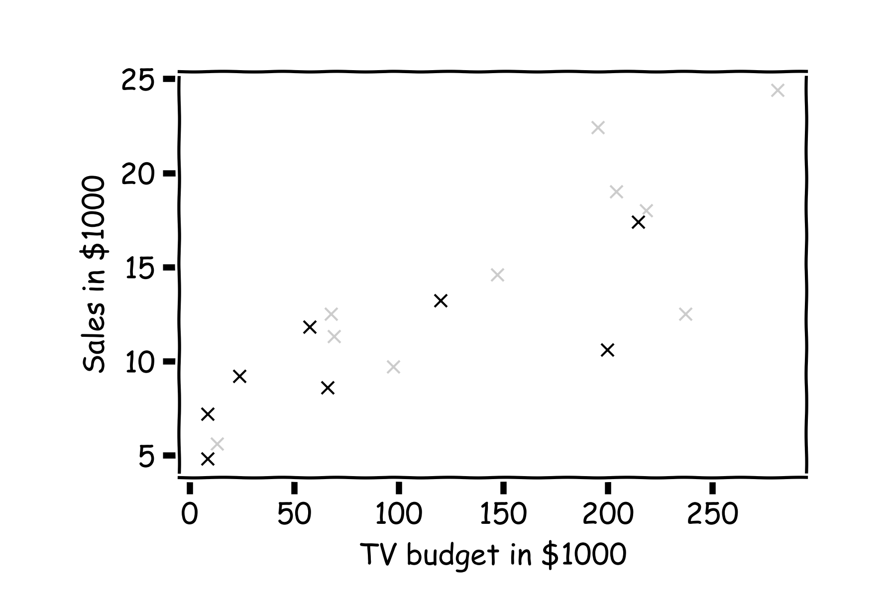
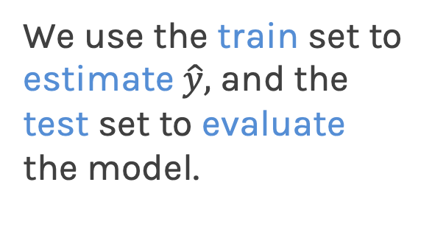
Error Evaluation
Hide some of the data from the model. This is called train-test split.
We use the train set to estimate $\hat{y},$ and the test set to evaluate the model.

Slide 7
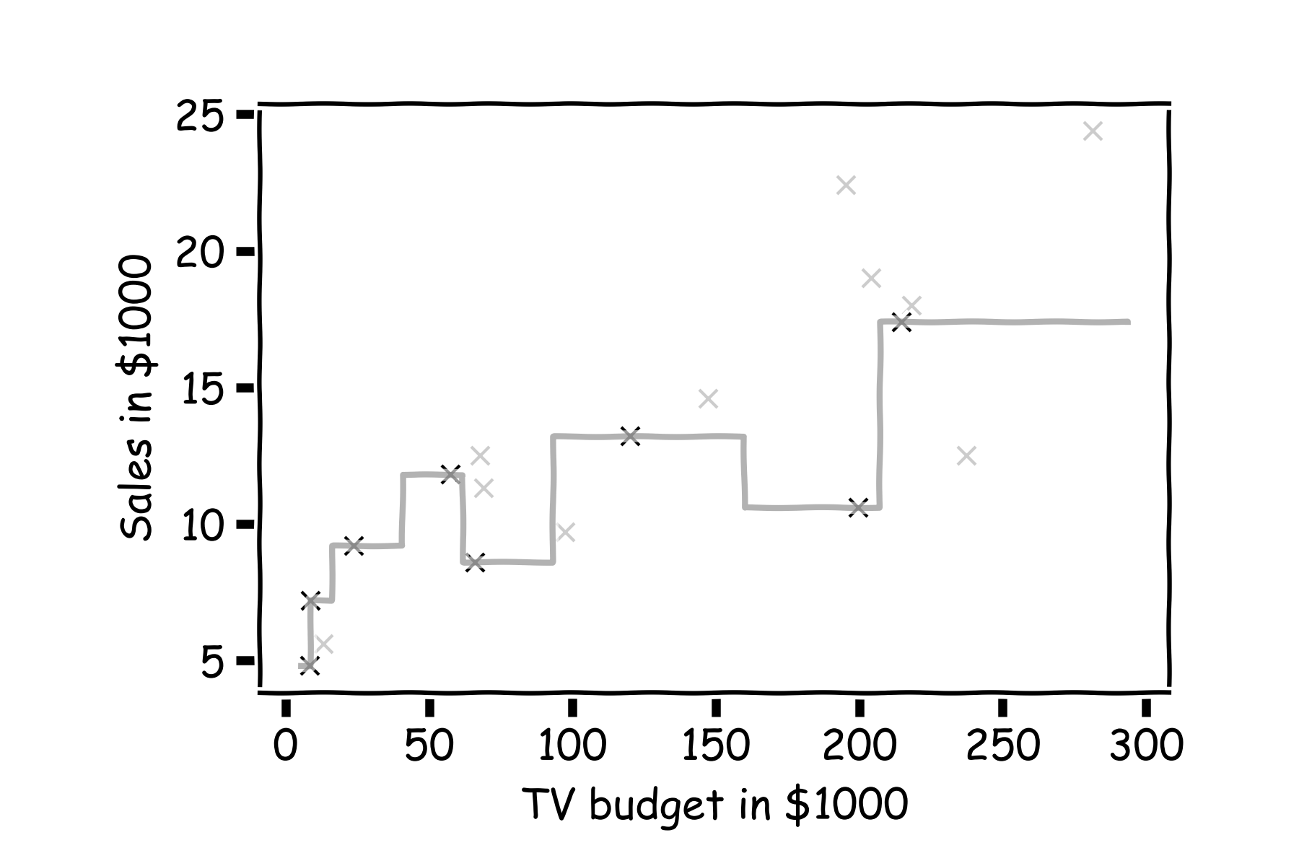
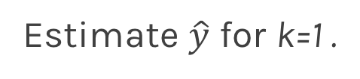
Error Evaluation
Estimate $\hat{y}$ for k=1 .
Notes:
Change indeces and show k-nearest

Slide 8
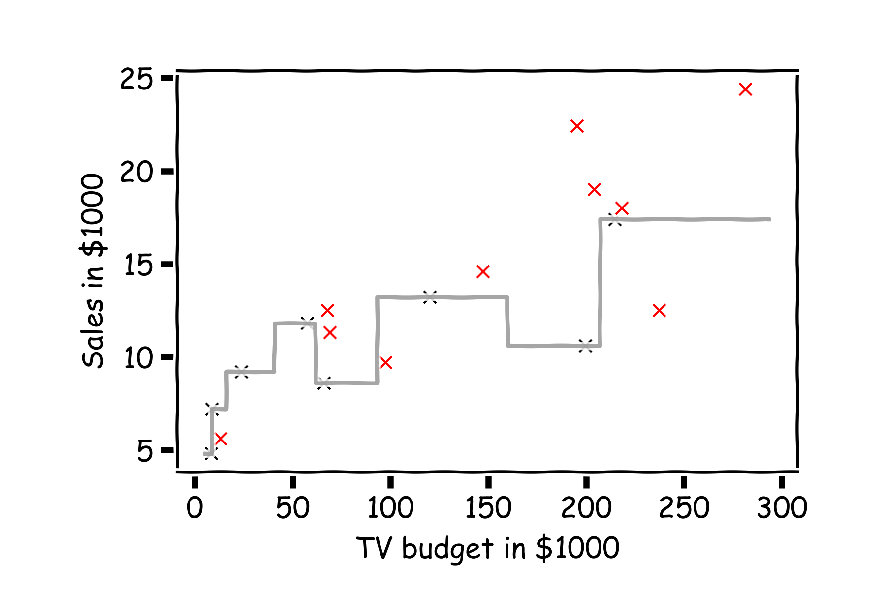
Error Evaluation
Now, we look at the data we have not used, the test data (red crosses).
Notes:
Change indeces and show k-nearest

Slide 9
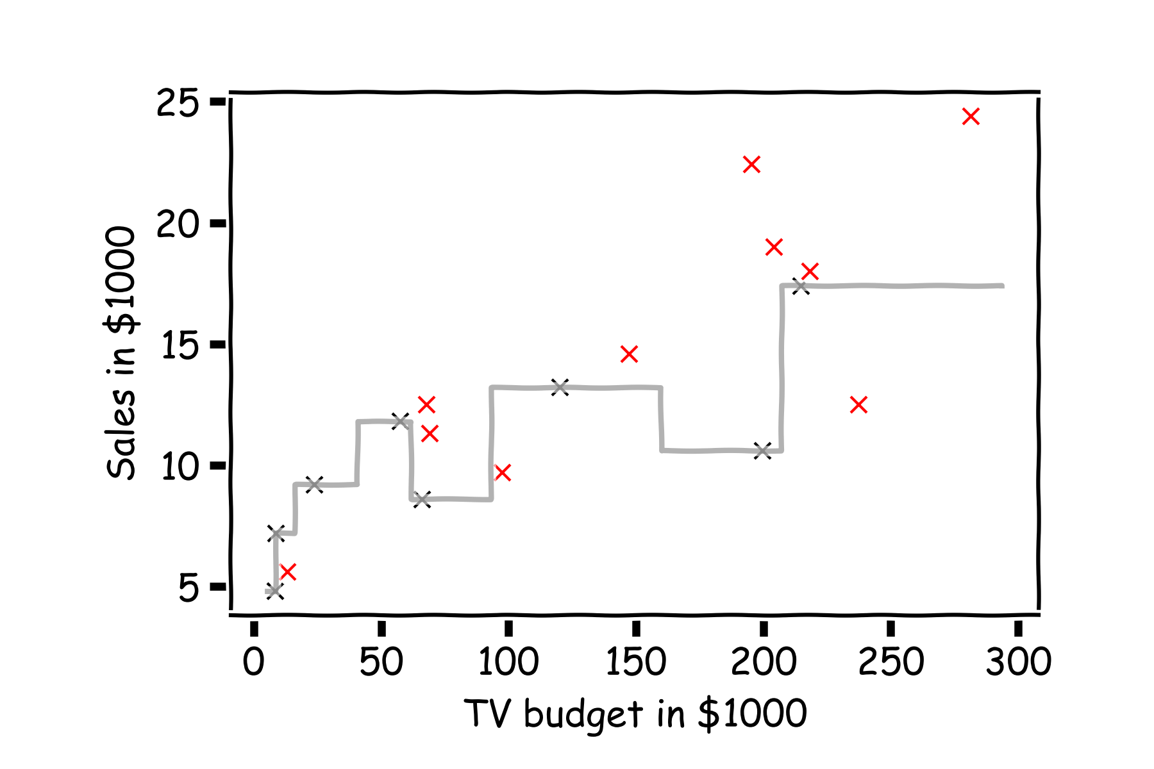
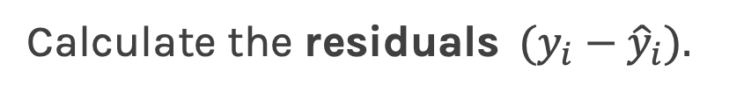
Error Evaluation
Calculate the ${\text{residuals} (y}_{i}−{\hat{y}}_{i}).$
Notes:
Change indeces and show k-nearest

Slide 10
Error Evaluation
In order to quantify how well a model performs, we aggregate the errors and we call that the loss or error or cost function.
A common loss function for quantitative outcomes is the Mean Squared Error (MSE):
Note: Loss and cost function refer to the same thing. Cost usually refer to the total loss where loss refers to a single training point.

Slide 11
Error Evaluation
Caution: The MSE is by no means the only valid (or the best) loss function!
Max Absolute Error
Mean Absolute Error
Mean Squared Error
Note: The square Root of the Mean of the Squared Errors (RMSE) is also commonly used.

Slide 12
Model Comparison

Slide 13
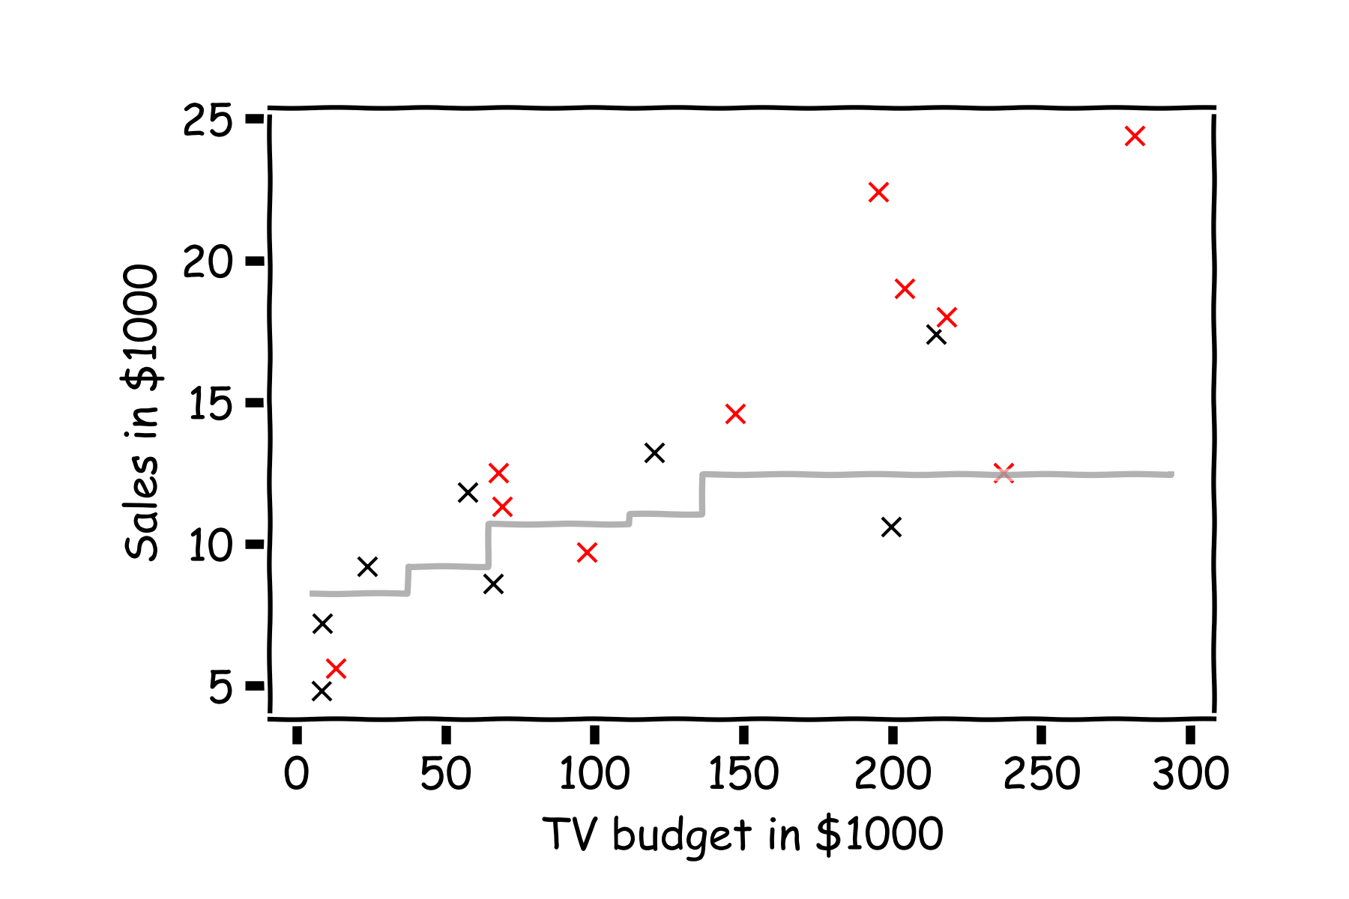
Error Evaluation
Do the same for k=3.

Slide 14
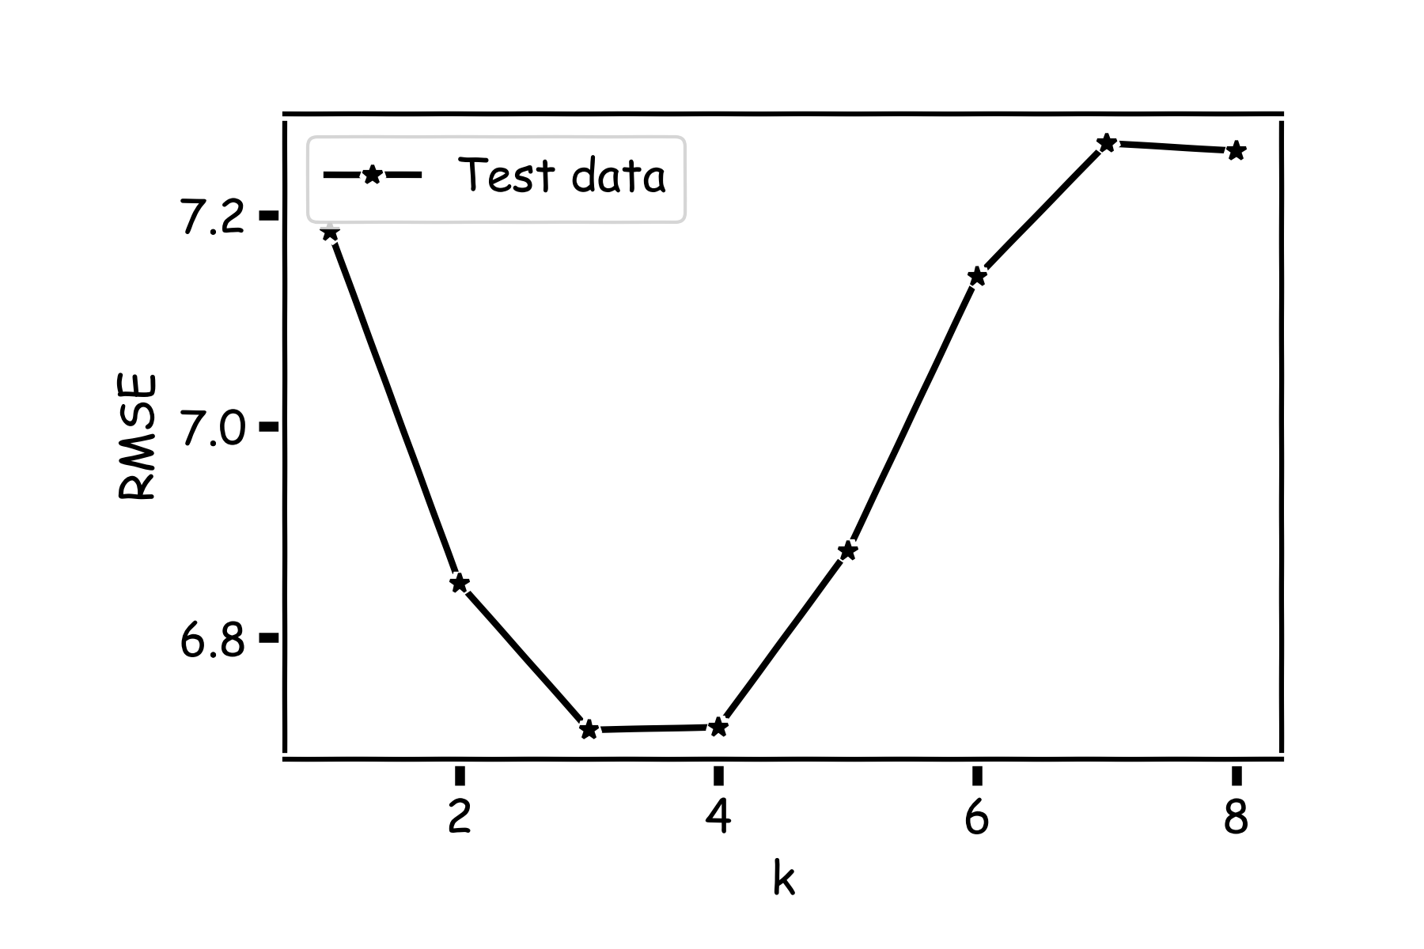
Model Comparison
Do the same for all k’s and compare the RMSEs. k=3 seems to be the best model.

Slide 15
Model Fitness

Slide 16
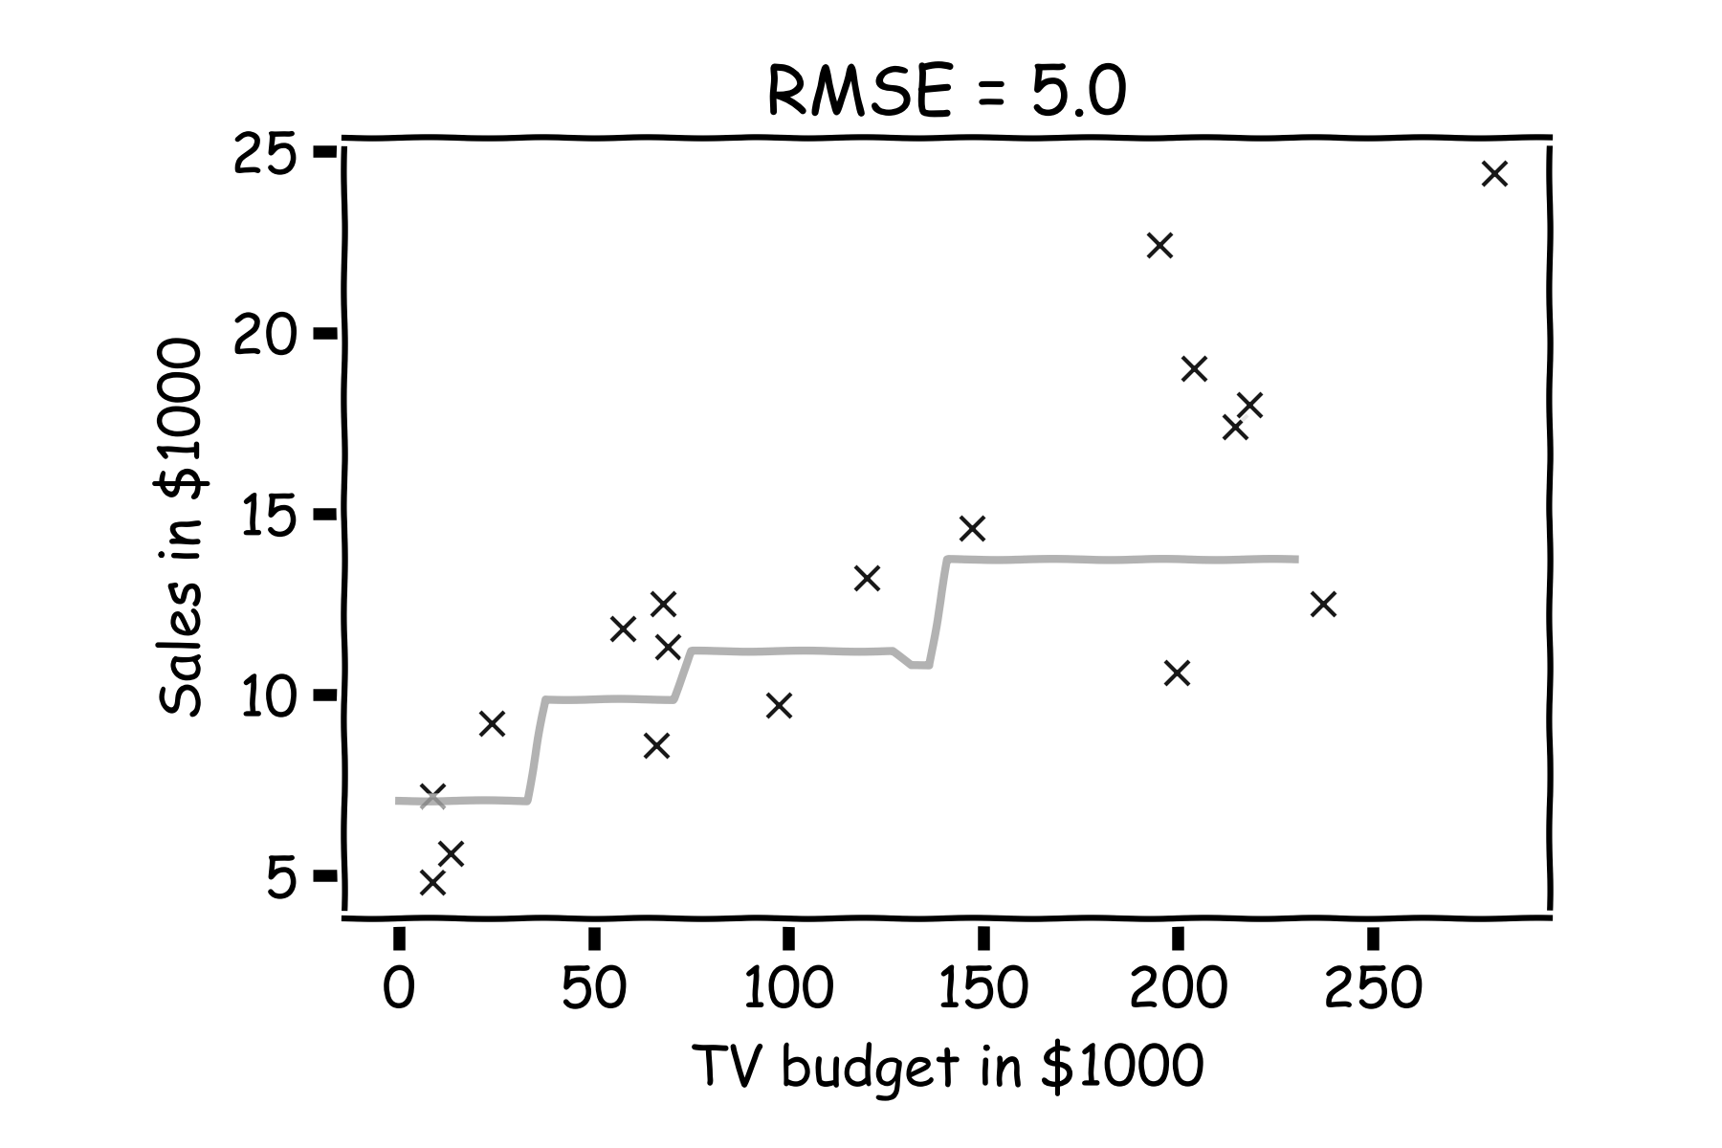
Model fitness
For a subset of the data, calculate the RMSE for k=3.
Is RMSE=5.0 good enough?

Slide 17
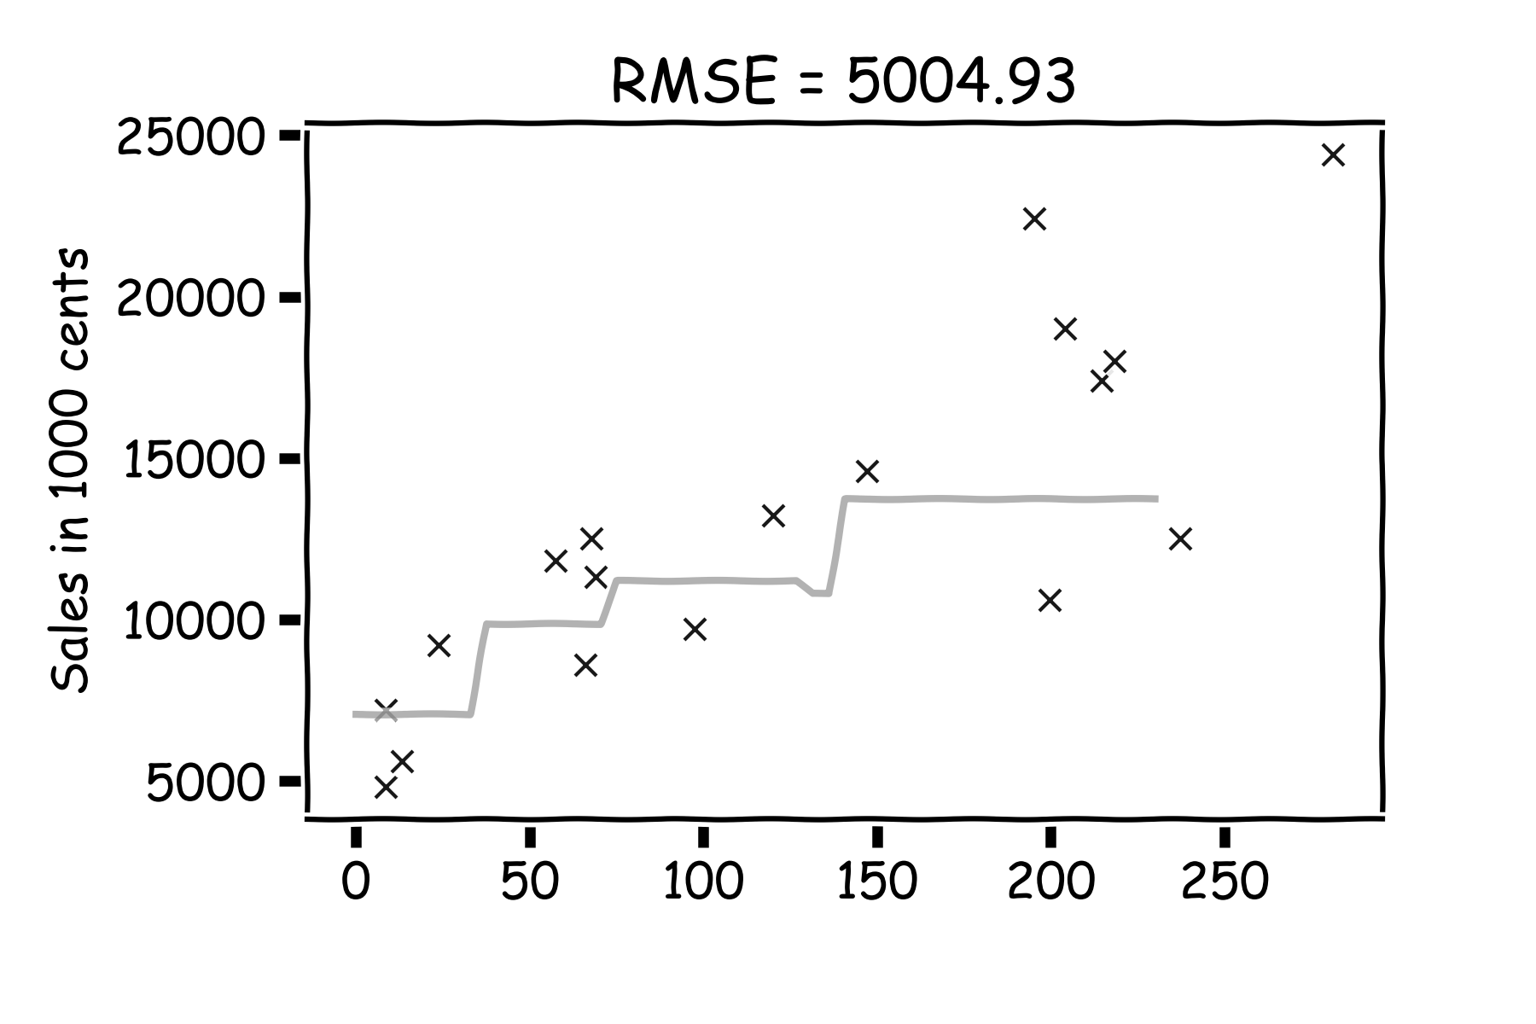
Model fitness
What if we measure the Sales in cents instead of dollars?
RMSE is now 5004.93.
Is that good?

Slide 18
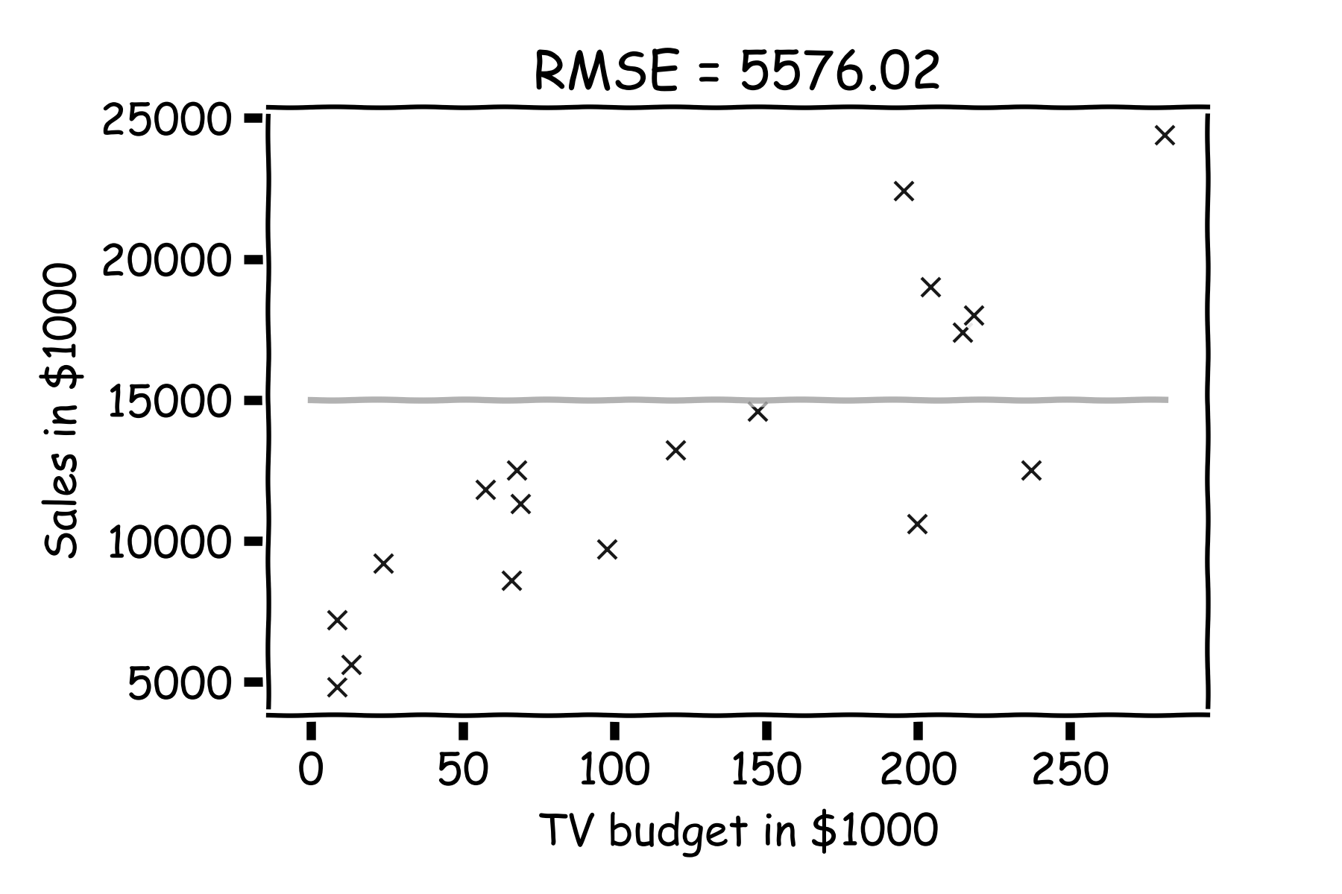
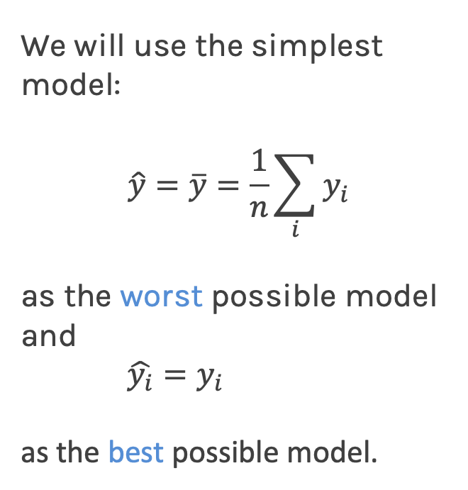
Model fitness
It is better if we compare it to something.
We will use the simplest model:
$$\hat{y}=\overline{y}=\frac{1}{n}\sum_{i}{y_{i}}$$
as the worst possible model and
$\hat{y_{i}}=y_{i}$
as the best possible model.

Slide 19
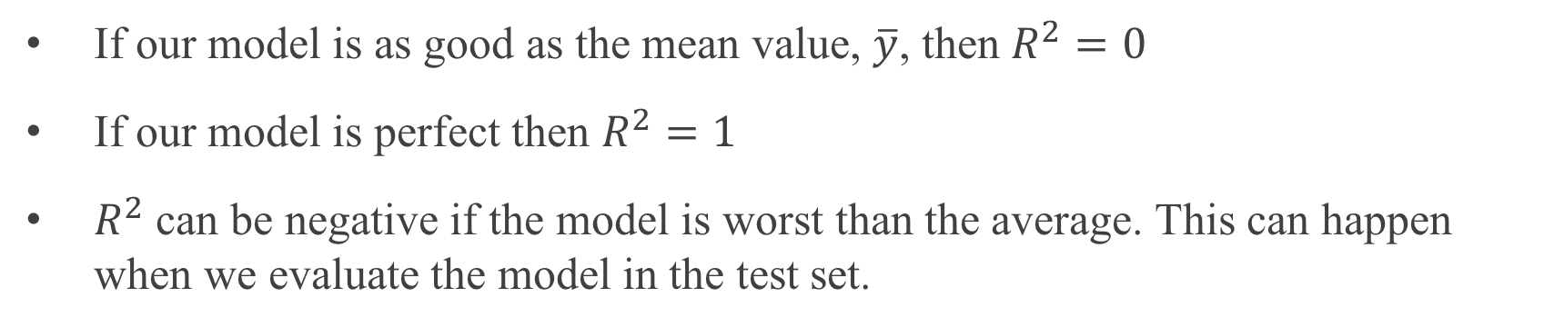
R-squared
If our model is as good as the mean value, $\overline{y}$, then $R^{2}=0$
If our model is perfect then $R^{2}=1$
$R^{2}$ can be negative if the model is worst than the average. This can happen when we evaluate the model in the test set.

Slide 20
Ex B.1

